Slide 1
List, Stacks, Queues and Priority Queues

Slide 2
Collection
The Collection in Java is a framework that provides an architecture to store and manipulate the group of objects.
Java Collections can achieve all the operations that you perform on a data such as searching, sorting, insertion, manipulation, and deletion.
Java Collection means a single unit of objects. Java Collection framework provides many interfaces (Set, List, Queue, Deque) and classes (ArrayList, Vector, LinkedList, PriorityQueue, HashSet, LinkedHashSet, TreeSet).

Slide 3
List
List Interface is the subinterface of Collection.
It contains index-based methods to insert and delete elements. It is a factory of ListIterator interface.

Slide 4
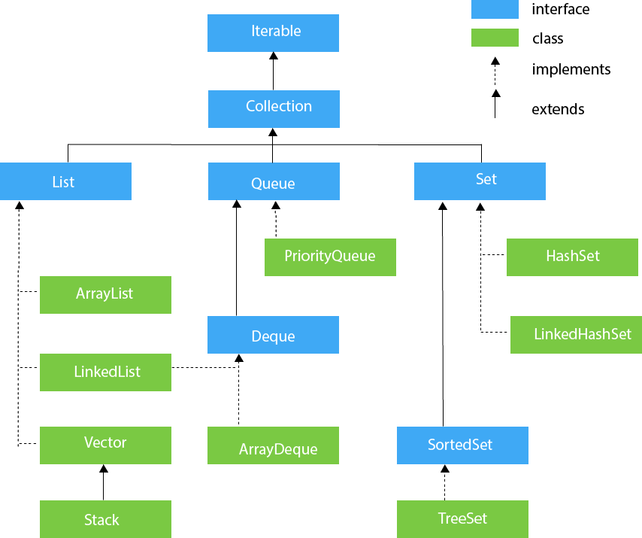

Slide 5
List Interface (methods)
Sr. | Method Name
1 | void add(int index, Object obj) Inserts obj into the invoking list at the index passed in index. Any pre-existing elements at or beyond the point of insertion are shifted up. Thus, no elements are overwritten.
2 | boolean addAll(int index, Collection c) Inserts all elements of c into the invoking list at the index passed in index. Any pre-existing elements at or beyond the point of insertion are shifted up. Thus, no elements are overwritten. Returns true if the invoking list changes and returns false otherwise.
3 | Object get(int index) Returns the object stored at the specified index within the invoking collection.
4 | int indexOf(Object obj) Returns the index of the first instance of obj in the invoking list. If obj is not an element of the list, .1 is returned.
5 | int lastIndexOf(Object obj) Returns the index of the last instance of obj in the invoking list. If obj is not an element of the list, .1 is returned.

Slide 6
List Interface (methods) (cont.)
Sr. | Method Name
6 | ListIterator listIterator( ) Returns an iterator to the start of the invoking list.
7 | ListIterator listIterator(int index) Returns an iterator to the invoking list that begins at the specified index.
8 | Object remove(int index) Removes the element at position index from the invoking list and returns the deleted element. The resulting list is compacted. That is, the indexes of subsequent elements are decremented by one
9 | Object set(int index, Object obj) Assigns obj to the location specified by index within the invoking list.
10 | List subList(int start, int end) Returns a list that includes elements from start to end.1 in the invoking list. Elements in the returned list are also referenced by the invoking object.

Slide 7
Iterator
An iterator is an interface that is used in place of Enumerations in the Java Collection Framework. Moreover, an iterator differs from the enumerations in two ways:
Iterator permits the caller to remove the given elements from the specified collection during the iteration of the elements.
Method names have been enhanced.

Slide 8
Methods | Description
hasNext() | Returns a true value if the more number of elements are encountered during iteration.
next() | Returns the next specified element during the iteration.
remove() | Removes the last element from the collection as provided by the iterator.

Slide 9
import java.util.Iterator;
import java.util.LinkedList;
import java.util.List;
public class JavaIteratorExample1 {
public static void main(String[] args) {
List<String> list = new LinkedList<>();
list.add("Welcome");
list.add("to");
list.add("SPCE");
list.add("OOP-I");
System.out.println("The list is given as : "+list);
Iterator<String> itr = list.iterator();
//Returns true if there are more number of elements.
while(itr.hasNext()) {
//Returns the next element.
System.out.println(itr.next());
}
//Removes the last element.
itr.remove();
System.out.println("After the remove() method is called : "+list);
}
}
The list is given as : [Welcome, to, SPCE, OOP-I] Welcome to SPCE OOP-I After the remove() method is called : [Welcome, to, SPCE]

Slide 10
The Comparator interface
Java Comparator interface is used to order the objects of a user-defined class.
This interface is found in java.util package and contains 2 methods compare(Object obj1,Object obj2) and equals(Object element).
It provides multiple sorting sequences, i.e., you can sort the elements on the basis of any data member, for example, rollno, name, age or anything else.

Slide 11
Method | Description
public int compare(Object obj1, Object obj2) | It compares the first object with the second object.
public boolean equals(Object obj) | It is used to compare the current object with the specified object.

Slide 12
The Comparator Interface
Sometimes you want to insert elements of different types into a tree set. The elements may not be instances of Comparable or are not comparable. You can define a comparator to compare these elements. To do so, create a class that implements the java.util.Comparator interface. The Comparator interface has two methods, compare and equals.

Slide 13
The Comparator Interface
public int compare(Object element1, Object element2)
Returns a negative value if element1 is less than element2, a positive value if element1 is greater than element2, and zero if they are equal.
public boolean equals(Object element)
Returns true if the specified object is also a comparator and imposes the same ordering as this comparator.

Slide 14
Java Collection Framework hierarchy
A collection is a container object that represents a group of objects, often referred to as elements. The Java Collections Framework supports three types of collections, named sets, lists, and maps.

Slide 15
The List Interface
A set stores non-duplicate elements. To allow duplicate elements to be stored in a collection, you need to use a list. A list can not only store duplicate elements, but can also allow the user to specify where the element is stored. The user can access the element by index.

Slide 16
ArrayList and LinkedList
The ArrayList class and the LinkedList class are concrete implementations of the List interface. Which of the two classes you use depends on your specific needs. If you need to support random access through an index without inserting or removing elements from any place other than the end, ArrayList offers the most efficient collection. If, however, your application requires the insertion or deletion of elements from any place in the list, you should choose LinkedList. A list can grow or shrink dynamically. An array is fixed once it is created. If your application does not require insertion or deletion of elements, the most efficient data structure is the array.

Slide 17
java.util.ArrayList

Slide 18
java.util.LinkedList

Slide 19
The Collections Class
The Collections class contains various static methods for operating on collections and maps, for creating synchronized collection classes, and for creating read-only collection classes.

Slide 20
The Vector and Stack Classes
The Java Collections Framework was introduced with Java 2. Several data structures were supported prior to Java 2. Among them are the Vector class and the Stack class. These classes were redesigned to fit into the Java Collections Framework, but their old-style methods are retained for compatibility.

Slide 21
The Vector Class
In Java 2, Vector is the same as ArrayList, except that Vector contains the synchronized methods for accessing and modifying the vector. None of the new collection data structures introduced so far are synchronized. If synchronization is required, you can use the synchronized versions of the collection classes. These classes are introduced later in the section, “The Collections Class.”

Slide 22
Vector Class
Vector implements a dynamic array.
It is similar to ArrayList, but with two differences:
Vector is synchronized.
Vector contains many legacy methods that are not part of the collection framework
Vector proves to be very useful if you don't know the size of the array in advance or you just need one that can change sizes over the lifetime of a program.

Slide 23
Vector (constructor)
Sr. | Constructor and Description
1 | Vector( ) This constructor creates a default vector, which has an initial size of 10
2 | Vector(int size) This constructor accepts an argument that equals to the required size, and creates a vector whose initial capacity is specified by size:
3 | Vector(int size, int incr) This constructor creates a vector whose initial capacity is specified by size and whose increment is specified by incr. The increment specifies the number of elements to allocate each time that a vector is resized upward
4 | Vector(Collection c) creates a vector that contains the elements of collection c

Slide 24
Vector (method)
SN | Methods with Description
1 | void add(int index, Object element) Inserts the specified element at the specified position in this Vector.
2 | boolean addAll(Collection c) Appends all of the elements in the specified Collection to the end of this Vector, in the order that they are returned by the specified Collection's Iterator.
3 | void addElement(Object obj) Adds the specified component to the end of this vector, increasing its size by one.
4 | int capacity() Returns the current capacity of this vector.
5 | void clear() Removes all of the elements from this Vector.
6 | boolean contains(Object elem) Tests if the specified object is a component in this vector.
7 | boolean containsAll(Collection c) Returns true if this Vector contains all of the elements in the specified Collection.

Slide 25
Vector (method) (cont.)
SN | Methods with Description
8 | Enumeration elements() Returns an enumeration of the components of this vector.
9 | Object firstElement() Returns the first component (the item at index 0) of this vector.
10 | Object get(int index) Returns the element at the specified position in this Vector.
11 | int indexOf(Object elem) Searches for the first occurence of the given argument, testing for equality using the equals method.
12 | boolean isEmpty() Tests if this vector has no components.
13 | Object lastElement() Returns the last component of the vector.

Slide 26
Vector (method) (cont.)
SN | Methods with Description
14 | int lastIndexOf(Object elem) Returns the index of the last occurrence of the specified object in this vector.
15 | Object remove(int index) Removes the element at the specified position in this Vector.
16 | boolean removeAll(Collection c) Removes from this Vector all of its elements that are contained in the specified Collection.
17 | Object set(int index, Object element) Replaces the element at the specified position in this Vector with the specified element.
18 | int size() Returns the number of components in this vector.

Slide 27
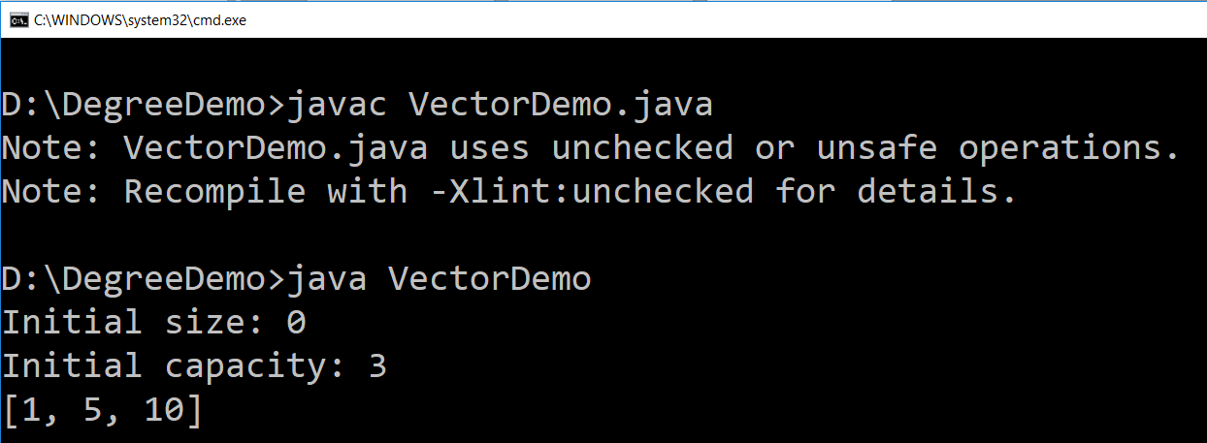
Vector (Example)
import java.util.*;
public class VectorDemo {
public static void main(String args[]) {
// initial size is 3, increment is 2
Vector v = new Vector(3, 2);
System.out.println("Initial size: " + v.size());
System.out.println("Initial capacity: " + v.capacity());
v.add(1);
v.add(10);
v.add(1, 5);
System.out.println(v);
}
}
index
value

Slide 28
The Stack Class
The Stack class represents a last-in-first-out stack of objects. The elements are accessed only from the top of the stack. You can retrieve, insert, or remove an element from the top of the stack.

Slide 29
Queues and Priority Queues
A queue is a first-in/first-out data structure. Elements are appended to the end of the queue and are removed from the beginning of the queue. In a priority queue, elements are assigned priorities. When accessing elements, the element with the highest priority is removed first.

Slide 30
The Queue Interface

Slide 31
The PriorityQueue Class

